Slide 1
MTH1203: Probability and Statistics
Lecture 07 (BSCS, BSDS, BSIT)
Chapter 3: Inferential Statistics
Dr. Daphne Nyachaki Bitalo
Department of Computing & Technology
Faculty of Engineering, Design & Technology

Slide 2
Lecture Objectives
The Objectives of this lecture are to:
Get an understanding of sampling techniques as it pertains to hypotheses formulated
Learn how to use the right sampling technique
Have hand’s on practicum with the aforementioned concepts

Slide 3
Lecture Overview
Inferential Statistics
Sampling techniques
Confidence Intervals
Regression analyses
Hand’s on practicum

Slide 4
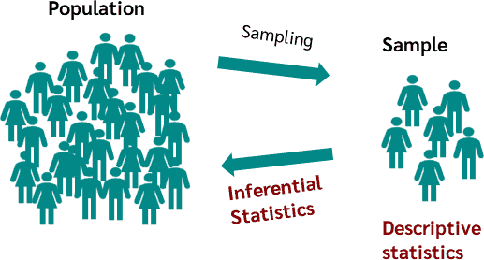
Inferential statistics
Descriptive statistics is a branch of statistics that summarizes and describes sample data
Inferential statistics describes a population from which the sample data is taken
Essence: Testing statements/hypotheses about the population based on the sample data

Slide 5
Inferential Statistics
Hypothesis formulation and testing
Sampling techniques
Confidence Intervals
Regression analyses
E.G. If the average age of completing undergraduate level at university in Kampala is 22, we can use this information to make inferences for the other districts of Uganda e.g. by hypothesis testing.
* So you get a sample group to interview and use that to make inferences for the total population.

Slide 6
Sampling techniques
Simple Random Sampling:
Every sample/member of the population has an equal probability of being selected since sampling is random
Pros: Simple to implement
Cons: A sampling error can occur if the sample does not end up accurately reflecting the population
E.g. if running a census using a random sampling technique, the sample might not have all the representative groups of the community e.g. PWD, leading to mis-reporting

Slide 7
Stratified random sampling
Approach:
Population is divided into random strata/groups
Strata can be criteria-based e.g. gender, age-group etc
Then a random sample of the strata is taken
Pros: Ensures precision (tailor-made to study)
Cons: Requires prior knowledge
E.g. in a research project targeted at understanding the performance off university students, person’s between the ages of 18-22 would be sampled, including males and females

Slide 8
Cluster sampling
Approach:
A form of probability sampling for larger populations that are spatially stratified/divided
Population is divided into known smaller groups/clusters
Clusters can be geographically-based e.g. districts, parishes
Pros: Suited to large studies
Cons: Can create bias
E.g. in a research project targeted at practices used by coffee farmers in Uganda, cluster sampling is done in major production districts like Mubende, Zombo, Mbale, Ntugamo, Mityana, Iganga to represent the country

Slide 9
Systematic sampling
Approach:
Selecting samples from a population at predetermined regular intervals
E.g. sampling every 11th customer for their reviews
E.g. sampling every 5th lab rat in an experiment of 1000 in a medical study
Cons: Can be biased if there’s no order in the pattern the samples appear.

Slide 10
Convenience sampling
Approach:
Selecting samples from a population based on their availability
E.g. seeking out perceptions about a product at a mall
E.g. sampling voters on who they’d choose for guild presidency
Pros: Simple and inexpensive
Cons: Highly prone to bias

Slide 11
Choosing the right sampling method
To minimise bias, sampling method choice is based on:
Population size and distribution: For large populations, cluster or systematic sampling might be more practical.
Resources available: Simple random sampling can be expensive for large populations.
Desired level of precision: Stratified sampling can improve precision.
Population diversity: If the population is diverse, stratified sampling can ensure representation of different groups.

Slide 12
Point estimation
Used for sample size estimation:
Sample size is a research term used for defining the number of individuals included in a research study to represent a population. The sample size references the total number of respondents included in a study, and the number is often broken down into sub-groups by demographics such as age, gender, and location so that the total sample achieves represents the entire population

Slide 13
Confidence Interval (Error of margin)
Determining sample size is a key aspect of statistics:
Measures degree of uncertainty or certainty in a sampling method
For instance in a survey sampling of 1000 respondents in a country, if the confidence interval is 6 and 60% that the sampled respondents have a positive review about a product
That implies that you can be confident that between 54% (60-6) and 66% (60+6) of the entire population would have responded positively to the product

Slide 14
Confidence level
The confidence level refers to the percentage of probability, or certainty that the confidence interval would contain the true population parameter when you draw a random sample many times.
It is expressed as a percentage and represents how often the percentage of the population who would pick an answer lies within the confidence interval.
For example, a 99% confidence level means that should you repeat the survey over and over again, 99% of the time, your results will match the results you get from a population.

Slide 15
Standard deviation
Measures a data set’s distribution from its mean. In calculating the sample size,
Useful in estimating how much the responses you receive will vary from each other and from the mean number, and the standard deviation of a sample can be used to approximate the standard deviation of a population.
The higher the distribution or variability, the greater the standard deviation and the greater the magnitude of the deviation.
For example, once you have already sent out your survey, how much variance do you expect in your responses? That variation in responses is the standard deviation.

Slide 16
Calculating sample size
Determine the population size (if known).
Determine the confidence interval.
Determine the confidence level.
Determine the standard deviation (a standard deviation of 0.5 is a safe choice where the figure is unknown)
Convert the confidence level into a Z-Score.

Slide 17
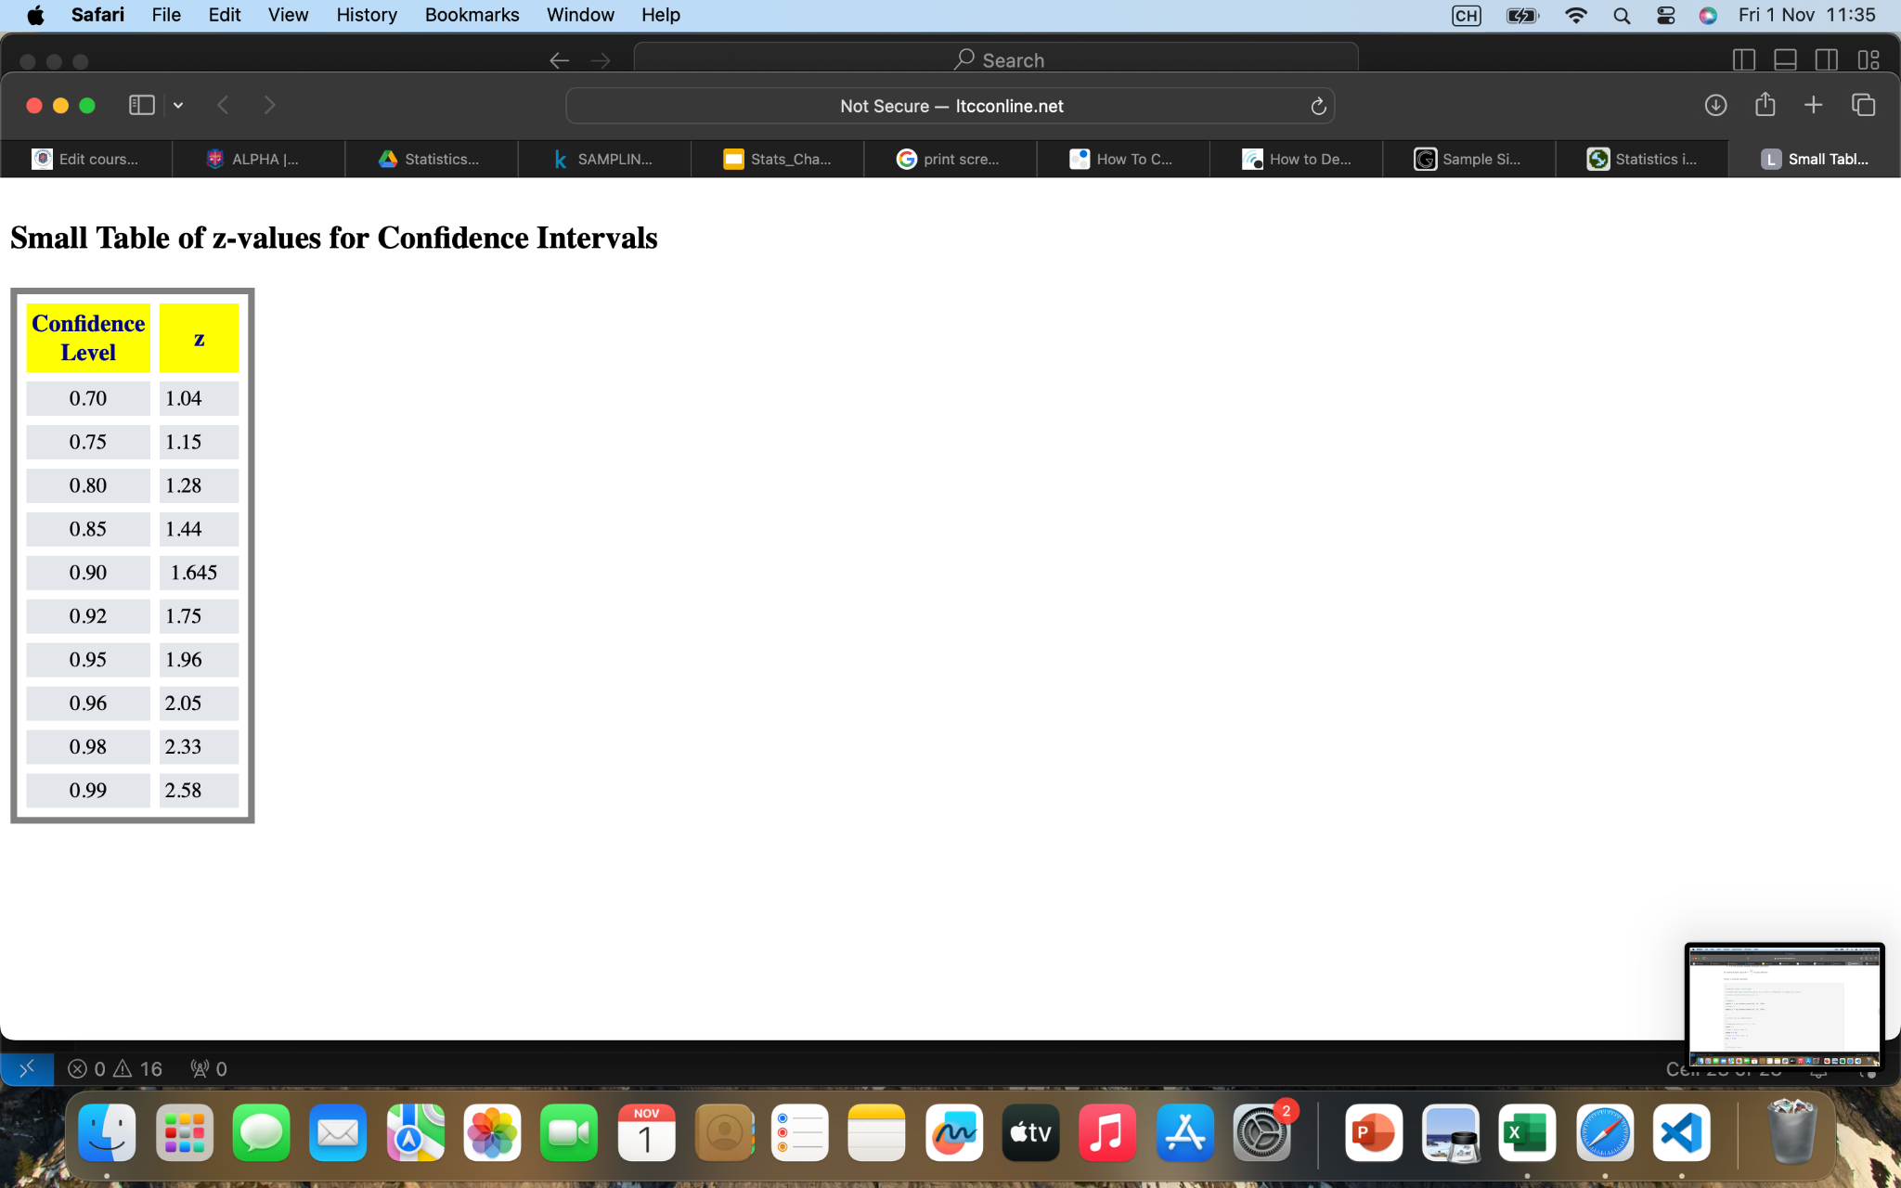
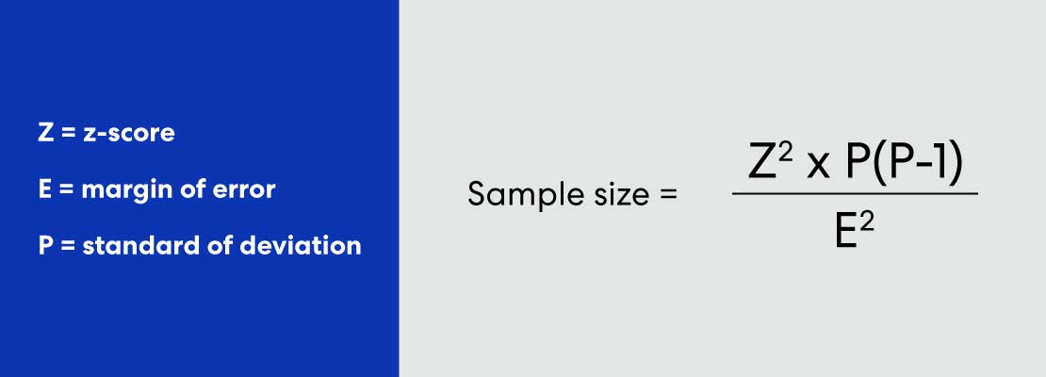
Calculating sample size for unknown population
Using Andrew Fisher’s formula and a z-score table
E.g. Find sample size at 95% confidence level, a standard deviation of 0.5, and a confidence interval (margin of error) of ± 5%

Slide 18
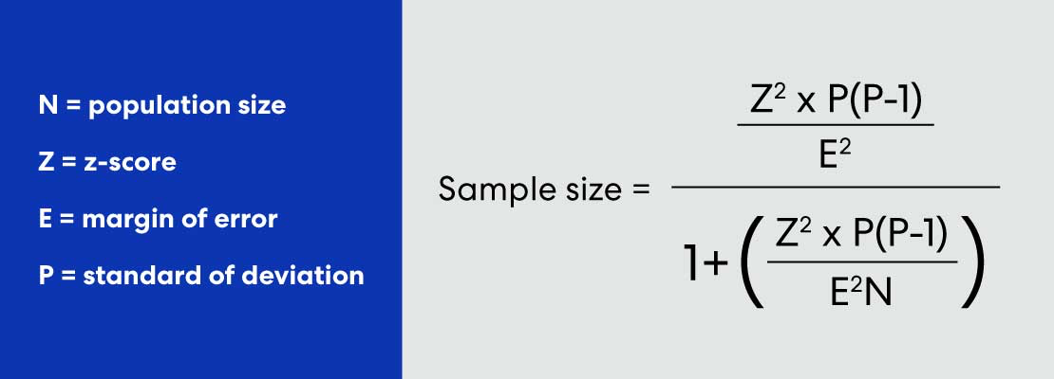
Calculating sample size for a known population
Using Andrew Fisher’s formula, a z-score table and the population size
Calculate sample size needed from a company of 500 people, with a 95% confidence level and 5% margin of error

Slide 19
Practicum using python
PRACTICAL 7 ON SAMPLING TECHNIQUES

Slide 20
Reading exercise
Further reading on the following topics for inferential statistics
Type I errors in hypothesis testing
Type II errors in hypothesis testing
Mitigating for statistical errors
Group Assignment:
Check Moodle for the group allocations
Working in assigned groups, generate powerpoint slides of the above topics to be presented in class (Friday 8th November 2024)

